Slide 1
What is the scientific method?

Slide 2
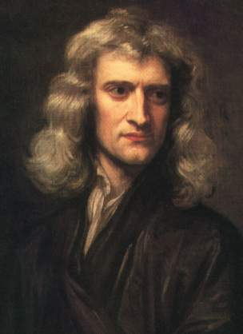
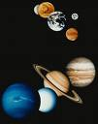
What is Science?
Isaac Newton (sec XVIII)
Universal Gravitation
A scientific theory is an attempt at a rational explanation of reality in a specific knowledge domain

Slide 3
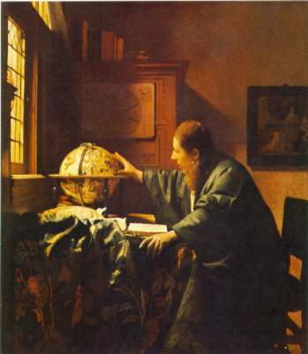
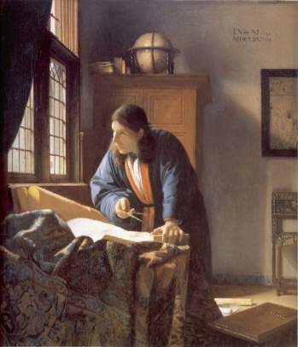
What is a scientific theory?
A scientific theory needs to say why something happens, say what cannot happen, and advance our knowledge of reality

Slide 4
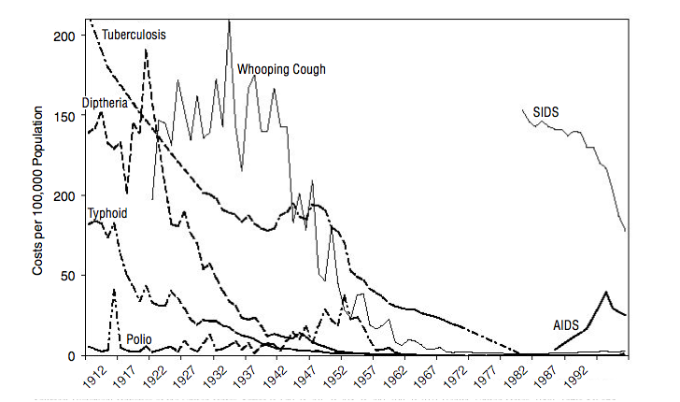
Infectious diseases in the U.S: XXth century

Slide 5
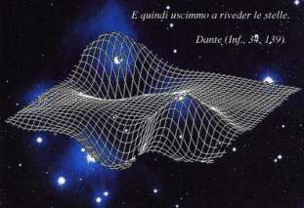
Science advances…
Universal
Gravitation
General Relativity

Slide 6
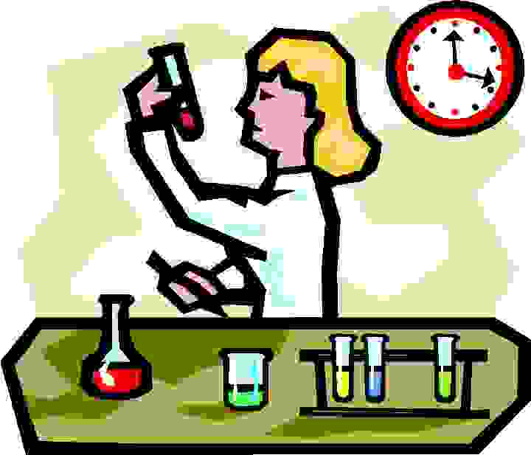
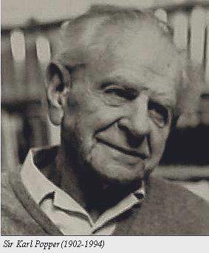
Karl Popper and the Scientific Method
Science starts with problems. Observations are designed to test if a theory is a solution to a problem

Slide 7
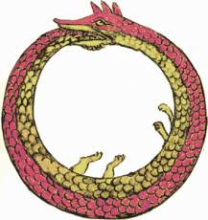
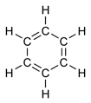
Popper: Conjectures and refutations
Problems leads to observations
Scientists use imagination
Testable
conjectures
Theories as conjectures: plausible statements about the universe, which can be subjected to critical testing, but we can never know if they are true or not

Slide 8
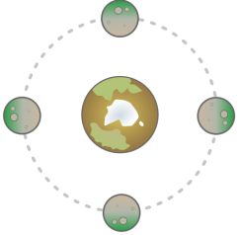
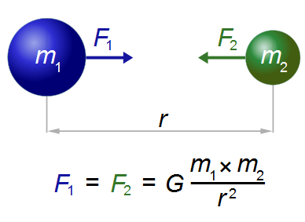
Universal gravitation as a conjecture
Observations
(Brahe, Galileo)
Conjecture
(Newton)
Universal gravitation (Newton) explains the motions of the planets measured by Galileo and Brahe. But gravitation is an anti-intuitive idea....

Slide 9
Universal gravitation as a conjecture
Observações
(Brahe, Galileo)
“That one body may act upon another at a distance through a vacuum without the mediation of anything else, by and through which their action and force may be conveyed from one another, is to me so great an absurdity that, I believe, no man who has in philosophic matters a competent faculty of thinking could ever fall into it. (Newton)”

Slide 10
Universal gravitation as a conjecture
Observações
(Brahe, Galileo)
“I have not yet been able to discover the cause of these properties of gravity from phenomena and I feign no hypotheses... It is enough that gravity does really exist and acts according to the laws I have explained, and that it abundantly serves to account for all the motions of celestial bodies...” (Newton)

Slide 11
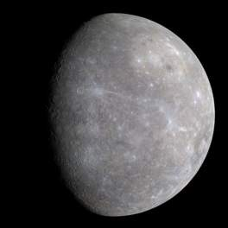
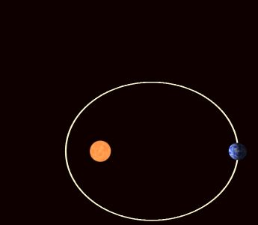
Refutation of universal gravitation?
Conjectura
(Newton)
Universal gravitation: error in estimating the precession of the perihelion of the planet Mercury (43 arcsec)

Slide 12
General relativity (Einstein)
Gravitation as a deformation of space-time (conjecture)
Detection of gravitational waves generated by the collision of two supermassive black holes by LIGO detectors

Slide 13
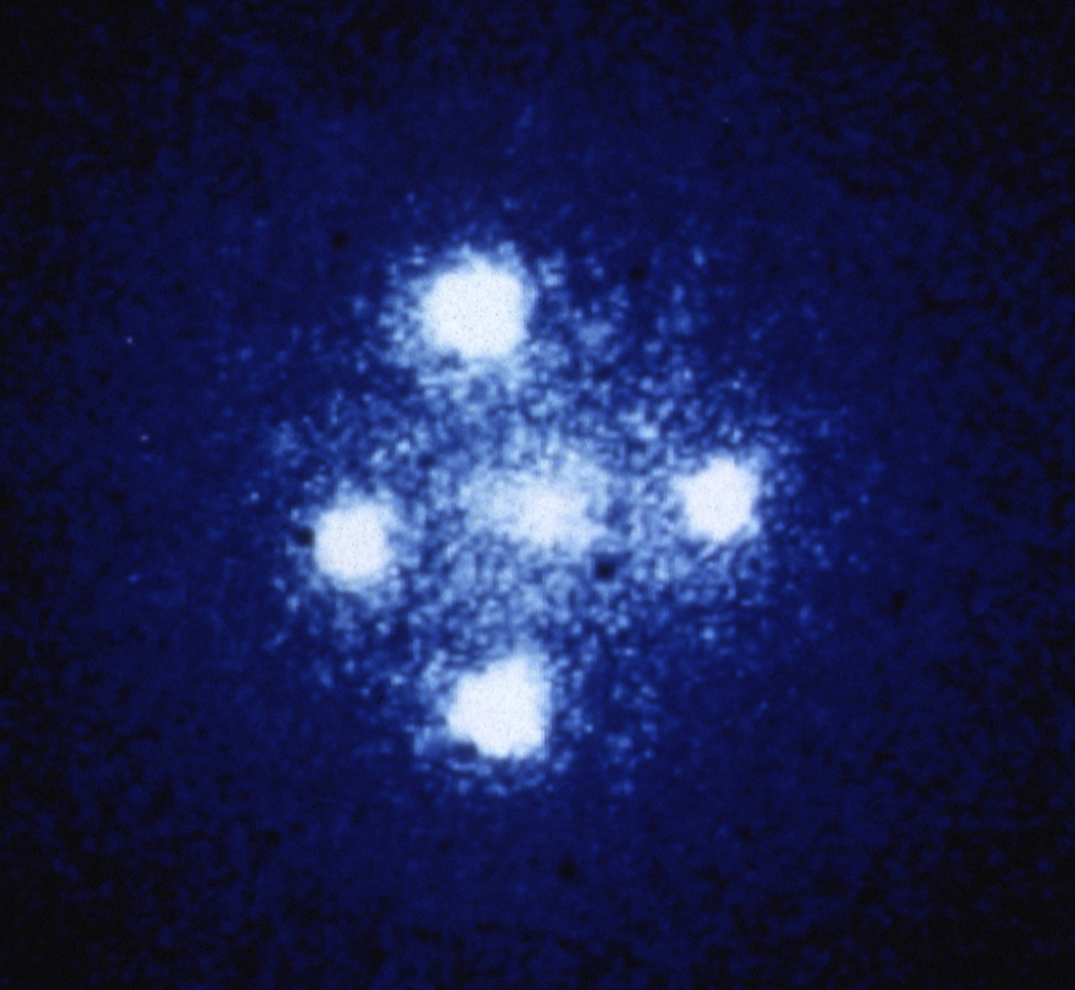
Einstein’s cross
The photograph shows four images of a very distant quasar which has been multiple-imaged by a relatively nearby galaxy acting as a gravitational lens.
The quasar seen here is at a distance of 8 billion light years, whereas the galaxy is at a distance of 400 million light years.
Gravitational lens G2237 + 0305
(Hubble Space Telescope)

Slide 14
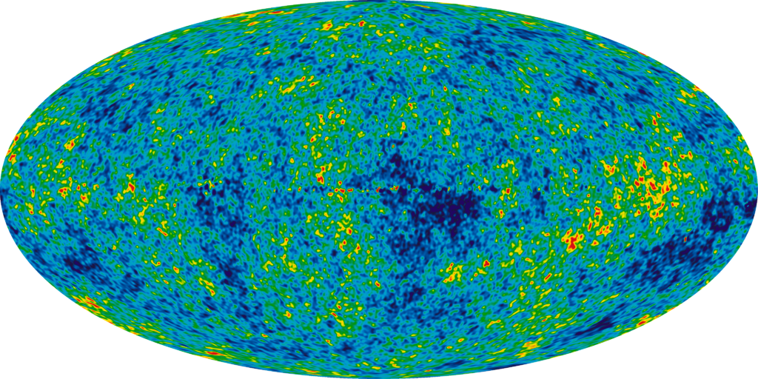
Popper: Science should be falsifiable
Cosmic microwave background - isotropic at 1:10⁶

Slide 15
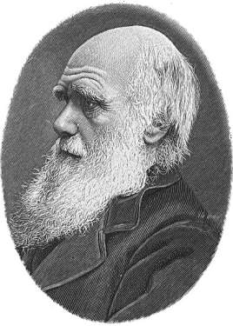
Is Darwin’s theory falsifiable?
How to build an experiment that falsifies evolution theory?
What evidence makes us confident that Darwin's theory is correct?

Slide 16
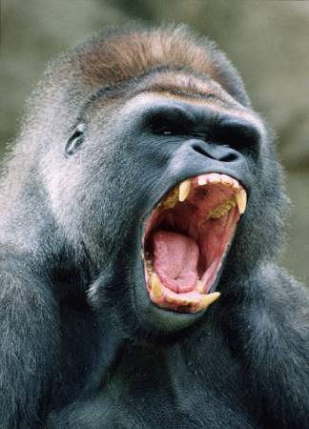

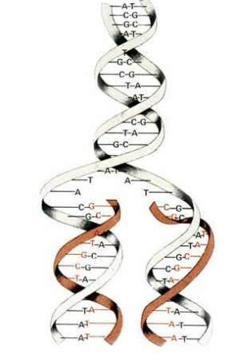
Evolution: experiments or observations?
Two humans could even have a 0.5% difference in DNA. The difference between chimpanzees and humans is only 1.23%. Human blood and Chimpanzee blood, with compatible blood groups, can be exchanged through transfusion

Slide 17
Evolution is supported by evidence

Slide 18
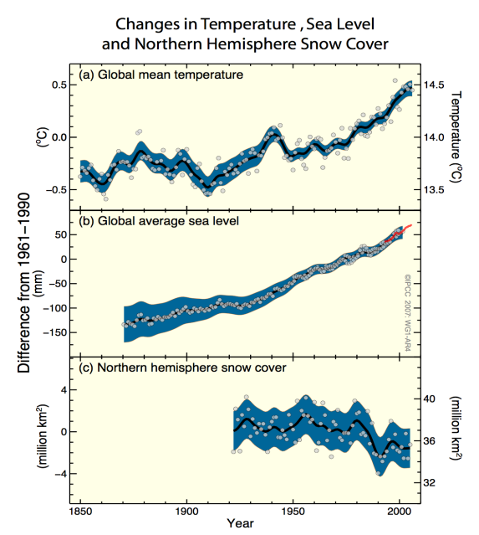
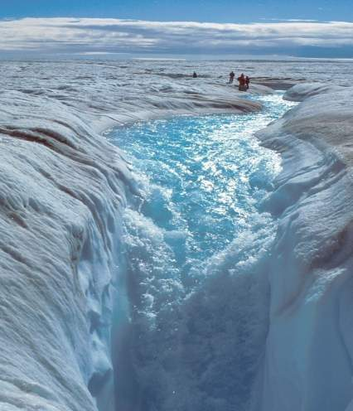
Evidence for global warming?
Redução no gelo da Groenlândia

Slide 19
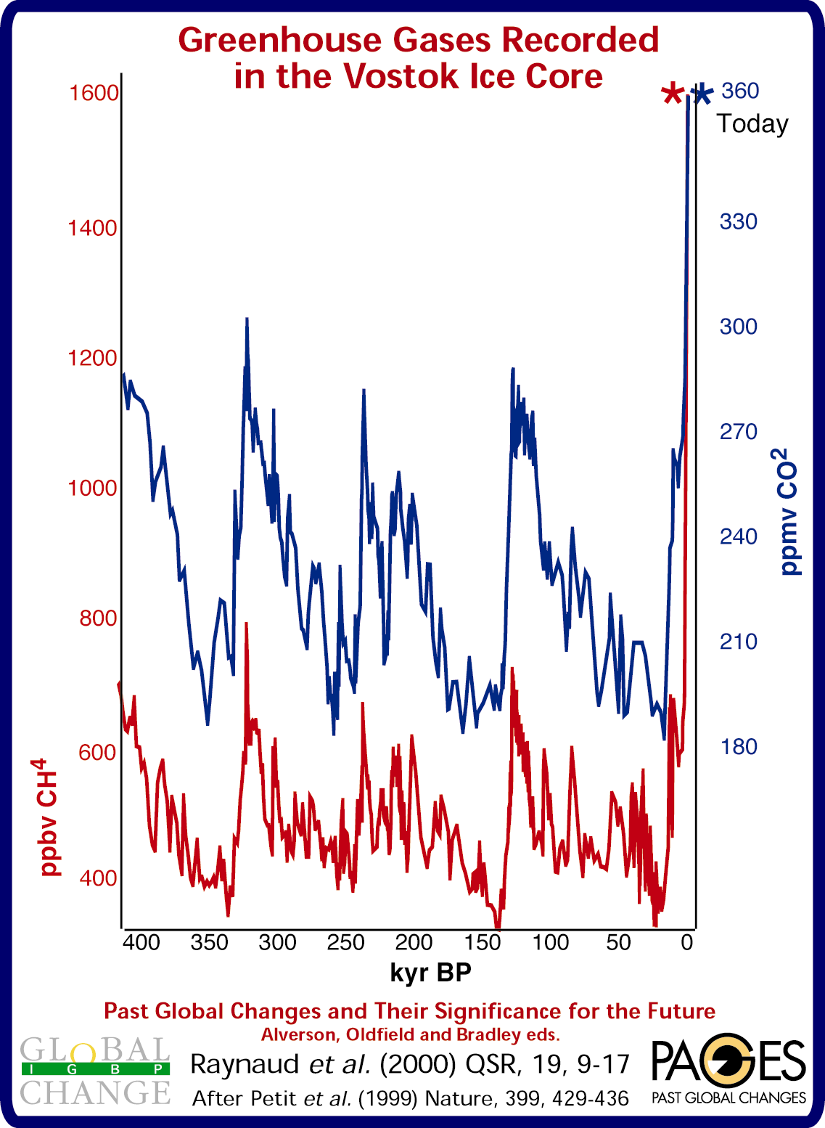
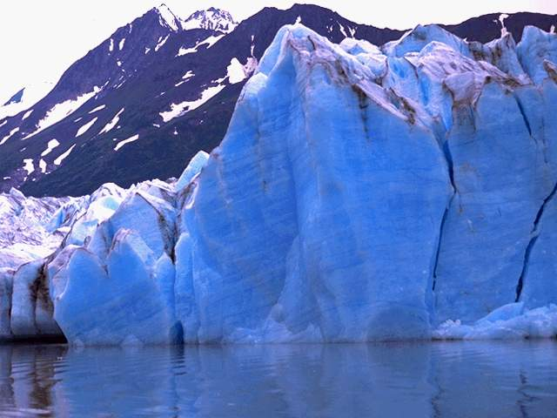

Slide 20


Science comes in many forms
Representation (theories and laws)
Matemathics
Computing & Modelling
Cosmology/Physics
Psicology
Earth Sciences
Life Sciences
Experiments (reproducible practice)

Slide 21

Scientific method: the mainstream view
Problem
(Introduction)
Conjecture
& Method
Experiments
with
Results
Discussion &
Conclusions

Slide 22
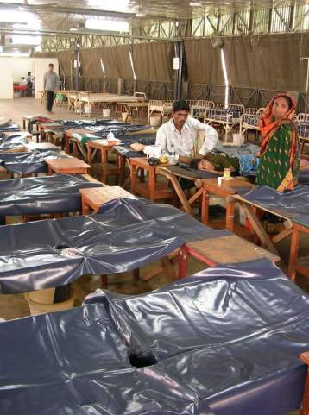
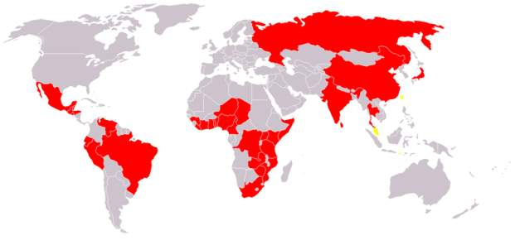
What is a problem (scientific question)?
How does cholera spread?

Slide 23
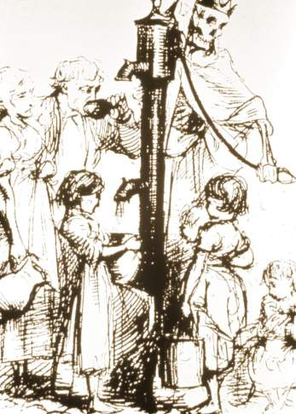
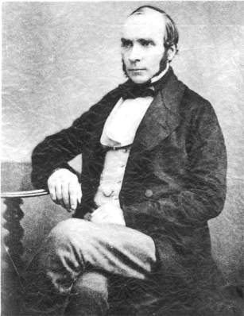
What is a hypothesis?
A conjecture to solve a problem
In 1849 the British physician, John Snow, proposed that cholera was spread through the contamination of water or food, as opposed to the more widely held belief that it spread through the inhalation of "bad vapors”.
"On the Mode of Communication of Cholera“ ( Snow, 1849)

Slide 24
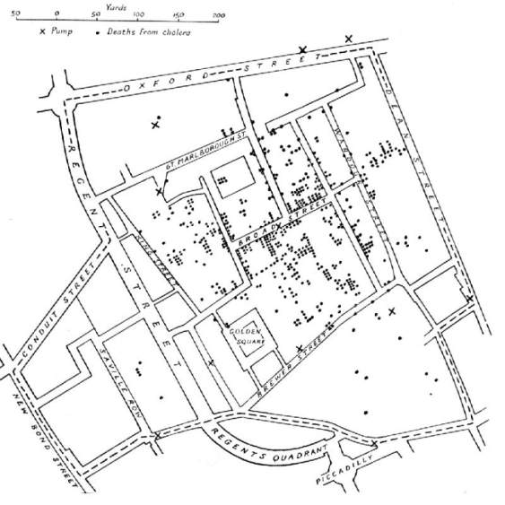
Experiment: confirm or deny conjecture
During the 1853-4 outbreak of cholera in London, John Snow was able to test his theory. In late August 1854, a heavy outbreak occurred in the area of Golden Square and Soho Square south of London's Oxford Street. Snow carefully reviewed records of all fatal cases of cholera.
Though his detective work, Snow constructed a spatial tally of all deaths in the area. There were thirteen water pumps in the area. Snow discovered that the heaviest casualties were clustered around the Broad Street water pump.

Slide 25
Experiment: confirm or deny conjecture
“Most public houses and coffee shops in the area mixed pump water with spirits. A local brewery that had its own water supply and allocated to its employees a free allowance of beer suffered no cholera deaths among its 70 workmen. A gentleman who came to see his dying brother arrived too late. He stayed only 20 minutes, but drank water from the Broad Street pump, and was attacked with cholera the next day and died.” (Snow)

Slide 26
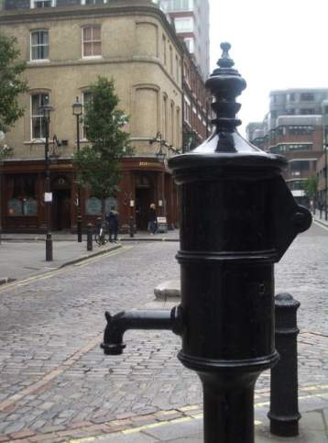
Discussion: what do the results show?
“I found that nearly all the deaths had taken place within a short distance of the [Broad Street] pump. (...) With regard to the deaths occurring in the locality belonging to the pump, there were 61 instances in which I was informed that the deceased persons used to drink the pump water from Broad Street.
The result of the inquiry, then, is, that there has been no particular outbreak or prevalence of cholera in this part of London except among the persons who were in the habit of drinking the water of the above-mentioned pump well”. (Snow)

Slide 27
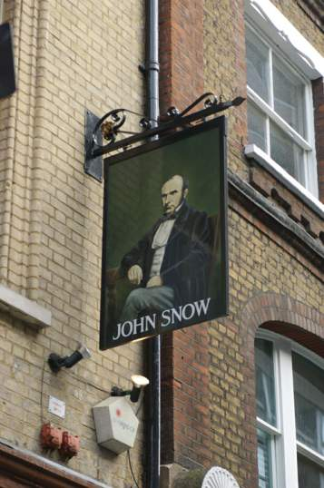
Conclusion: are the findings relevant?
Snow recommended to the local authorities that the handle be removed from the Broad Street pump, which was done in 8 September 1854. The removal of the pump handle correlated with a decline in cholera cases, but this decline may have been due to the natural shape of the epidemic and the fact that possible human hosts had deserted the area rather than the removal of the pump handle.
Authorities remained skeptical; Snow had not produced direct evidence of the "cholera poison" he claimed had caused the disease.

Slide 28
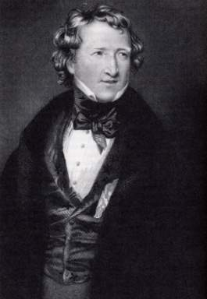
Competing scientific theories (Kuhn)
“Dr. Snow claims to have discovered that the law of propagation of cholera is the drinking of sewage water. His theory, of course, displaces all other theories. Other theories attribute great efficacy in the spread of cholera to bad drainage and atmospheric impurities. Therefore, says Dr. Snow, gases from animal and vegetable decompositions are innocuous! If this logic does not satisfy reason, it satisfies a theory; and we all know that theory is often more despotic than reason.” (Editorial, The Lancet, 1855)
Thomas Wakley,
“The Lancet”

Slide 29
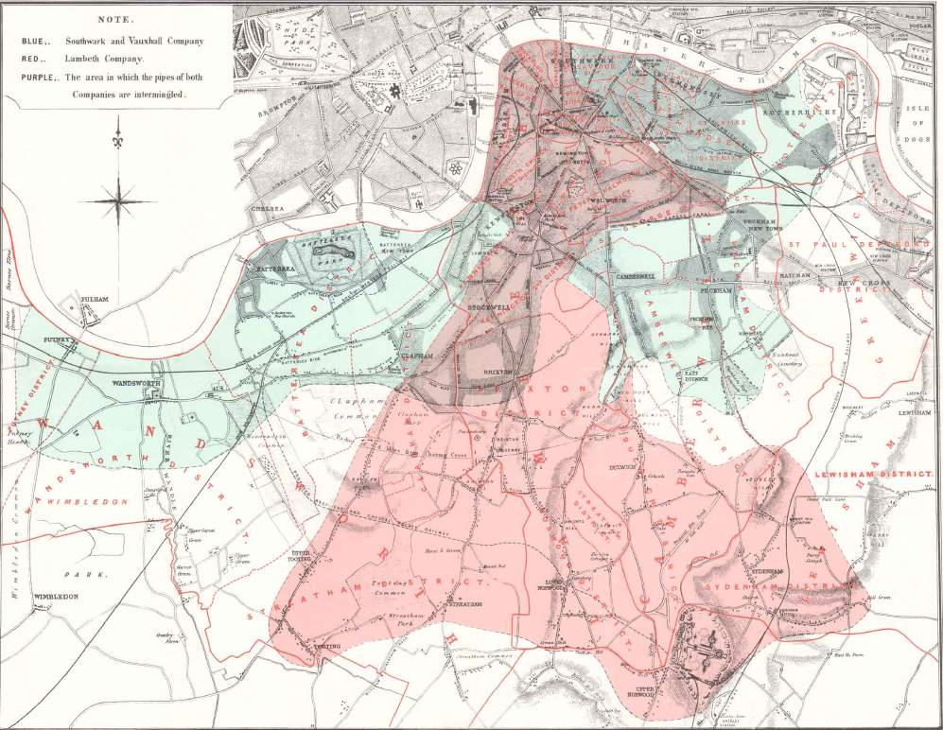
"The Grand Experiment” (Snow)
.
Two water companies serviced the London area: the Lambeth Water Company and the Southwark and Vauxhall Water Company. While the former took its water from the Thames about 20 miles upstream from the London city sewers, the later took its water downstream.
Snow examined records of the households serviced by the two water companies. Those serviced by Lambeth Water Company saw 37 deaths every 10,000 households and those serviced by Southwark and Vauxhall Water Company saw 315 deaths every 10,000 households.

Slide 30
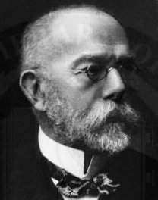
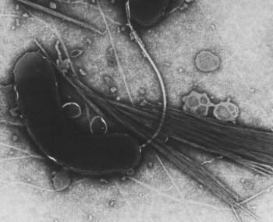
New paradigms are hard to be accepted
Discovery of vibrio cholera in 1883 (Koch)
In the international sanitary conference of 1885 attended by Robert Koch along with representatives of 28 countries, the British delegation successfully blocked any "theoretical discussion on the etiology of cholera”.

Slide 31
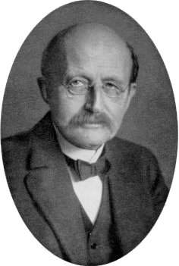
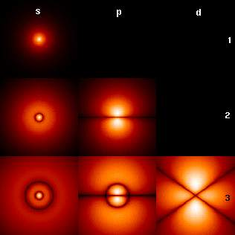
A new paradigm: quantum mechanics
Max Planck
Wave function
“A new scientific truth does not triumph by convincing its opponents and making them see the light, but rather because its opponents eventually die, and a new generation grows up that is familiar with it."

Slide 32

Kuhn: most Science is normal Science
Established paradigms
Unexpected results? Wrong experiment!

Slide 33
Kuhn: most Science is normal Science
When doing normal science, failure of a result to conform to the expectation is seen not as refuting the paradigm, but as the mistake of the researcher.
As anomalous results build up, science reaches a crisis, at which point a new paradigm emerges.

Slide 34
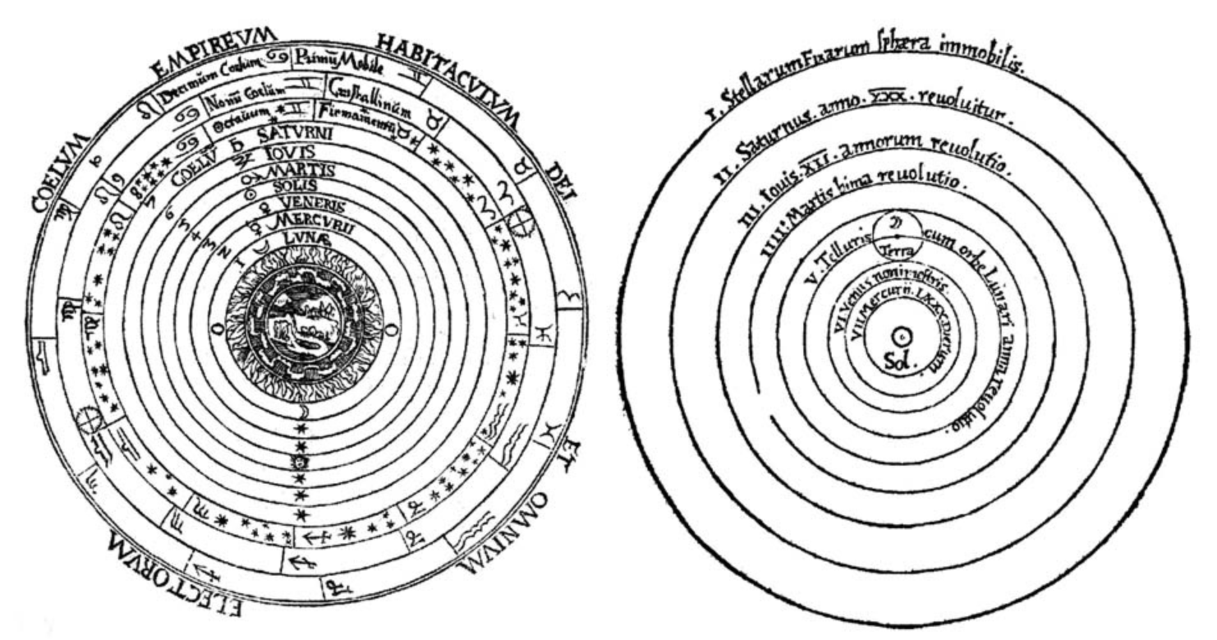
Kuhn: Scientific revolutions
Ptolomeus (geocentric)
Copernicus (heliocentric)

Slide 35
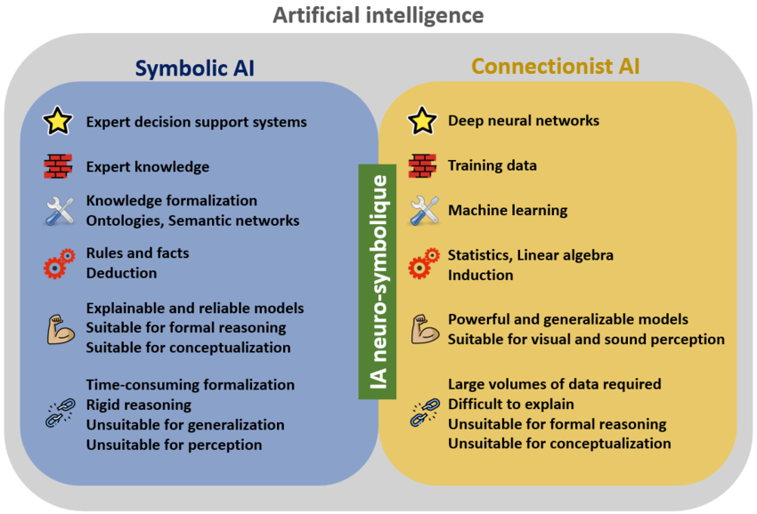
Kuhn: Scientific revolutions

Slide 36
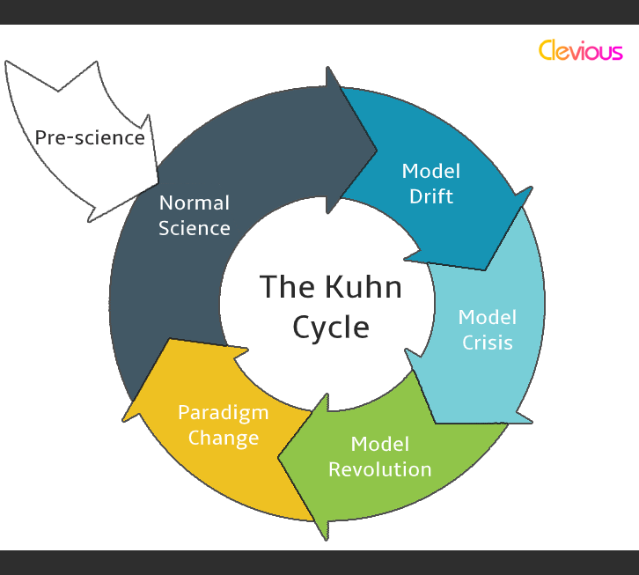
Kuhn: normal science x paradigm change

Slide 37
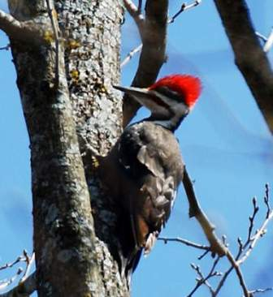
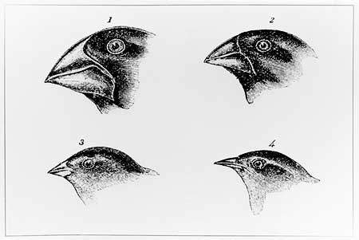

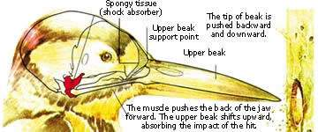
O método científico ao alcance de (quase) todos
Porque o picapau não tem dor de cabeça?
Hipótese: Deve ser por causa dos mecanismos evolutivos…
Experimento: descrever as adaptações dos picapaus
"Woodpeckers and Head Injury“, P.May et al, Lancet, 307,1976.

Slide 38
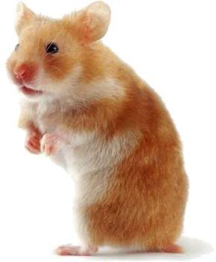
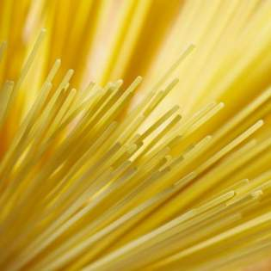
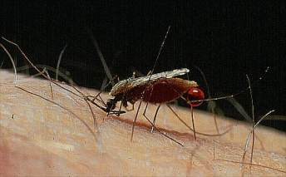
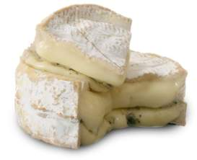
O método científico ao alcance de (quase) todos
Como curar o jet lag de hamsters?
Porque o espaguete nunca quebra na metade?
Porque o queijo malcheiroso atrai o mosquito da malária?
Proc Nat Academy of Sciences
Physical Review Letters
The Lancet

Slide 39
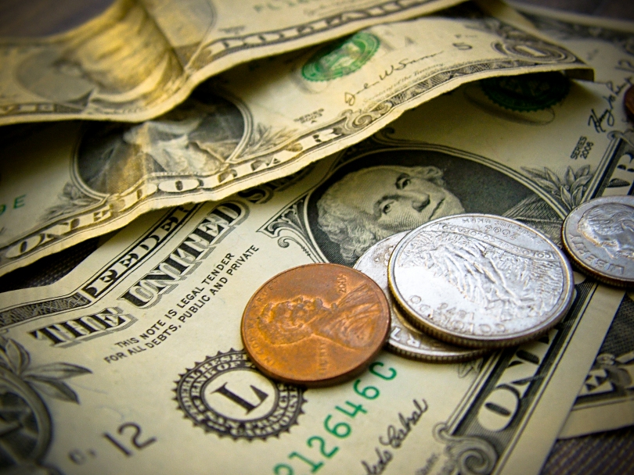
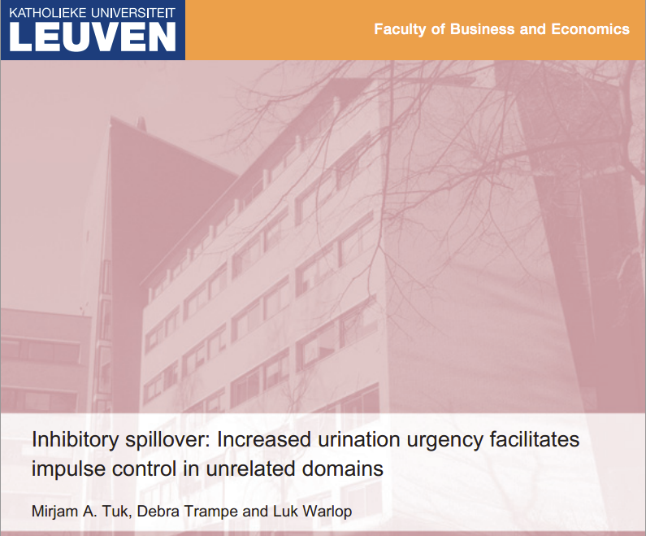
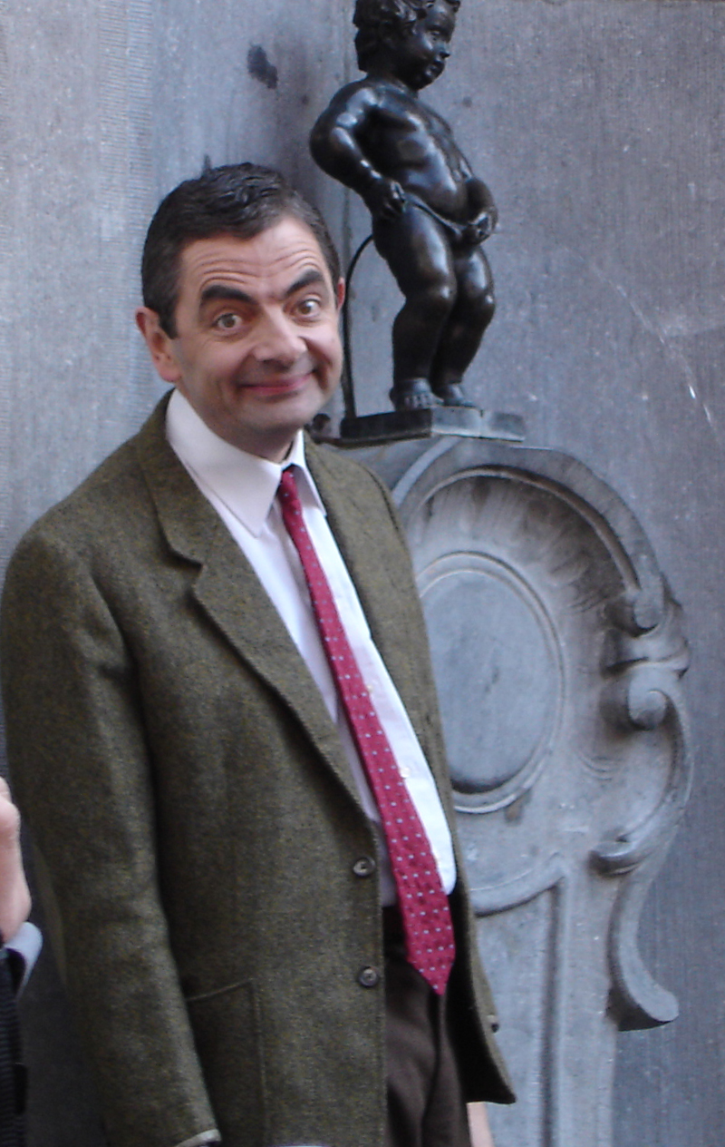
Vontade de urinar x dinheiro ($ 16 hoje ou $35 em dois meses?)

Slide 40
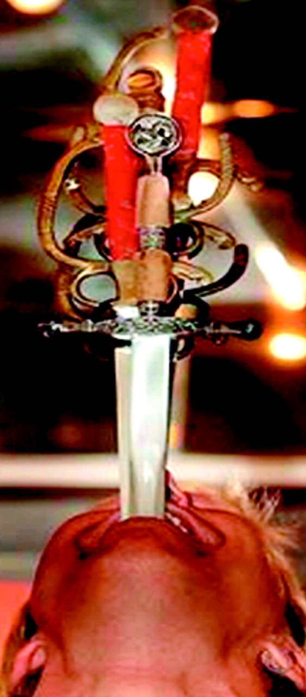

Sword swallowing and its side effects
Brian Witcombe and Dan Meyer, British Medical Journal, December 23, 2006, vol. 333, pp. 1285-7.

Slide 41





Slide 42

Com um bom problema e uma boa metodologia, quase tudo se publica...
Qual é o seu problema?

